Slide 1

Monitoring and resource usage

Slide 2
Why do we need to monitor?

Slide 3
Since we run and manage the service, we need to ensure it’s reliably available
People won’t use our stuff if it’s unreliable

Slide 4
The Golden Mantra:
Find and fix problems before your customer finds them

Slide 5
Using Monitoring to help us understand our software at runtime
Monitoring to tell us when there’s a problem
Monitoring to automate scaling and recovery

Slide 6
Understanding Our Software
Normal resource usage
Peaks and troughs in demand
Non optimized code

Slide 7
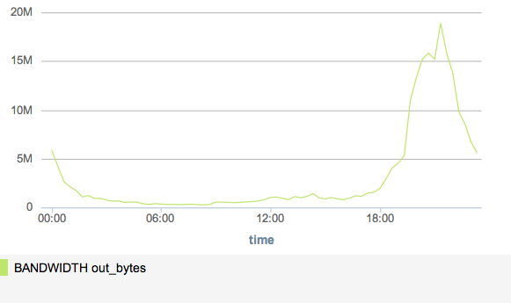
Understanding
Output from a live TV streaming server over a 24 hour period – comments?
Notes:
Note usage typically occurs in evening time and only for a few hours, but very dramatic growth in traffic over short period of time

Slide 8
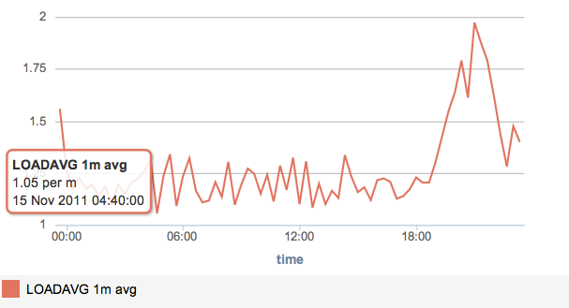
Notes:
Spike here

Slide 9
Things we learn:
When servers come under load, and best way to prepare
Bottlenecks in our product
What the user experienced when using the site
How our machines (and resources were managed)

Slide 10
Learning about Problems
Identifying problems early on our service helps us respond faster
Automated Monitoring using third party services frees us up to concentrate on building more features

Slide 11
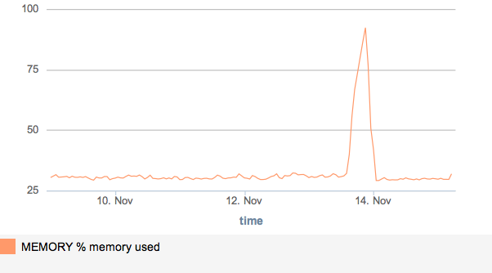
Our streaming server again, is this graph typical of a healthy machine?
Notes:
No!

Slide 12
Classifying issues
Problems
Warnings
Errors
Critical
Notifications via SMS, email, etc

Slide 13
Automate scaling
Set key thresholds for scaling up / down our service
Pre-emptively increase capacity ahead of a surge
Scale back infrastructure as demand drops off

Slide 14
Monitoring Services

Slide 15
Monitoring IaaS vs. Paas type applications
PaaS generally providers additional monitoring facilities
Not interested in memory usage of O/S performance in PaaS
Using IaaS, we need to monitor O/S as well as application

Slide 16
When monitoring IaaS, what are key things to watch out for?
CPU Usage
Load average
Memory Usage
Disk space usage etc.

Slide 17
+ all our specific app monitoring

Slide 18
Let’s look at what monitoring support is available from Amazon and Azure

Slide 19
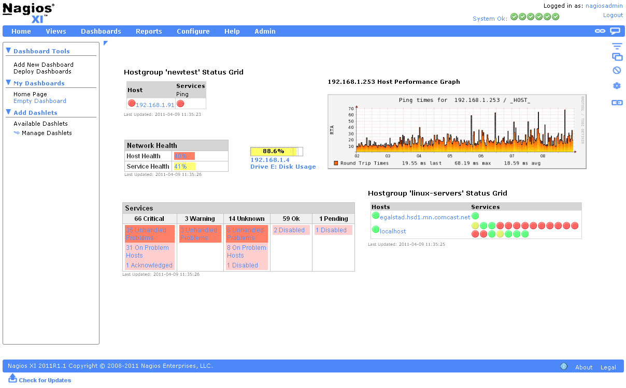
Nagios – Open source, suits DIY’ers

Slide 20
Q & A

